Slide 1
LOAN AMOUNT CHANGE PROCESS

Slide 2
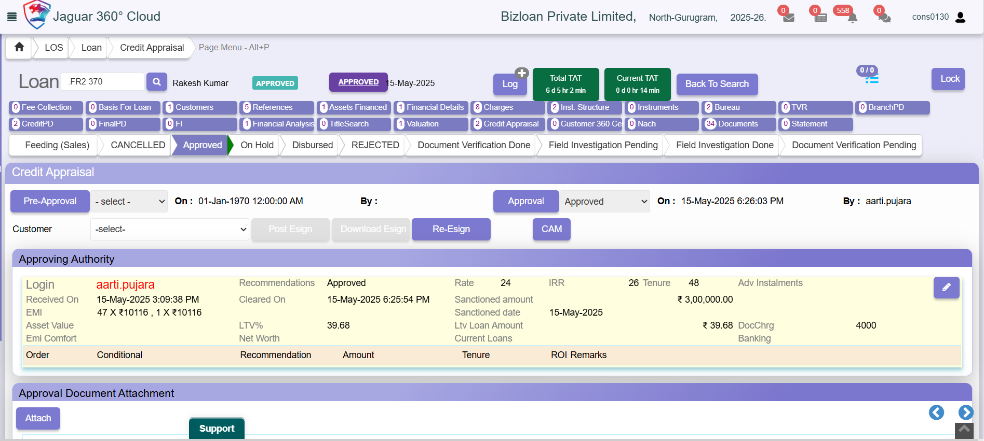
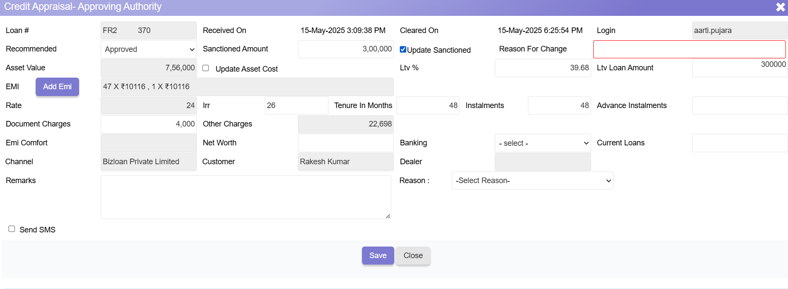
Step:- 1
Navigate to the Credit Appraisal Section
  Go to the Credit Appraisal module and click on Edit Credit Appraisal.
  Enable the Update Sanction toggle.
  You will now be able to update the Sanction Amount.
  Upon making changes, the system will prompt you to enter the Reason for Change. Provide a clear and valid explanation for the revision in the sanction amount.
  Within the Credit Appraisal – Approving Authority section, the authorized user can modify sanction-related details such as Sanction Amount, Tenure, and IRR.

Slide 3
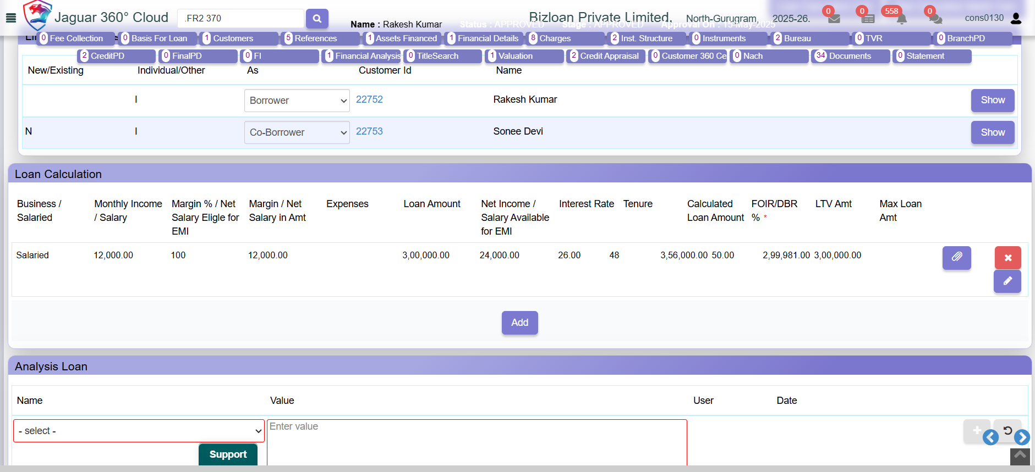
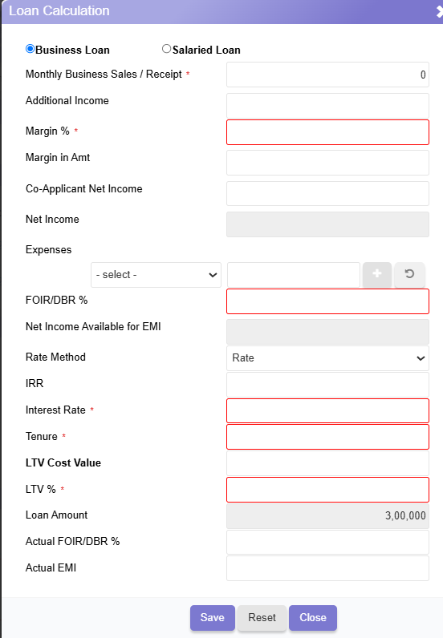
Step:- 2
Update Financial Analysis
  Navigate to the Financial Analysis section and click on the Add button.
  Update the Loan Calculation to reflect the revised sanction amount and related parameters.
Note:
Only users with Approval Authority ID can perform sanction amount modifications. This action is restricted and cannot be carried out by other user IDs.

